Slide 1
Evaluating the range
Numerical summaries of data

Slide 2
how to use Oak lessons

Slide 3
I can evaluate the range as a measure of spread, including a consideration of outliers.

Slide 4
outlier
range
spread/dispersion

Slide 5
An outlier is a data point that is extremely large or small compared to the rest of the dataset.
The range is a measure of spread. It is found by finding the difference between the highest and lowest values.
The spread/dispersion of data values describes how far apart the pieces of data are.

Slide 6

Evaluating the range
Outliers and their effect on the range
Evaluating if removing outliers is sensible

Slide 7
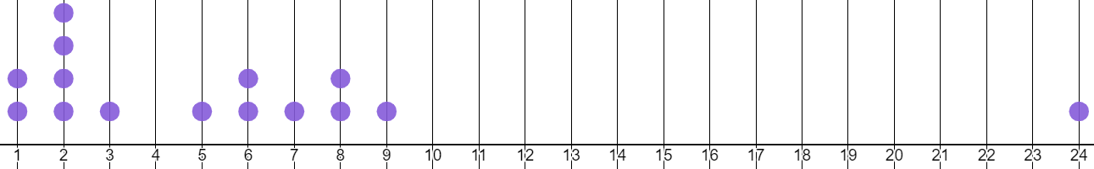
Outliers and their effect on the range
An outlier is a data point that is extremely large or small compared to the rest of the data set.
Visually, outliers lie far away from where the majority of the results are clustered.
dot plot A

Slide 8
Outliers and their effect on the range
The range of a data set is the:
value of the largest data point − value of the smallest data point
dot plot A
distance of 23 means a range of 23
On a dot plot, this is the same as finding the distance between the largest and smallest data point.

Slide 9
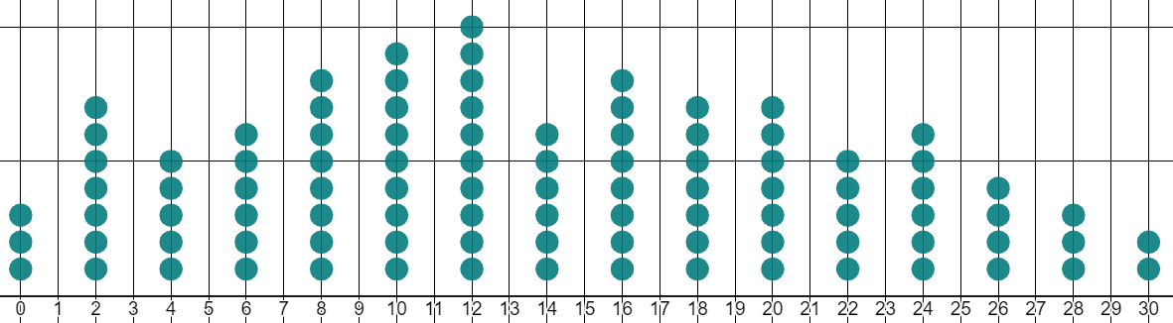
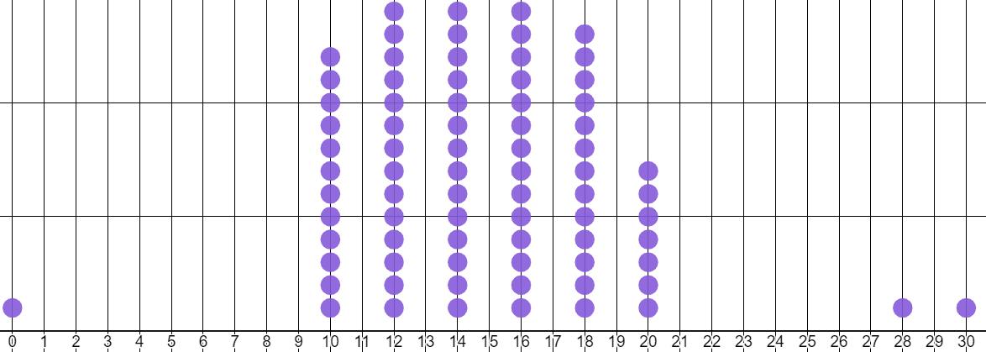
Outliers and their effect on the range
Which of these dot plots looks more varied or spread out?
A
Dot plot A is fairly evenly spread out across the whole range of 0 to 30.
B
Whilst dot plot B isn’t really spread out across the whole range. It is actually far less varied!

Slide 10
Outliers and their effect on the range
By removing these three outliers, this new range is more representative of how varied dot plot B is.
A
B
The outliers were too far away from where the majority of the results are clustered.

Slide 11
Outliers and their effect on the range
A
By removing these outliers, the range of dot plot B decreases from 30 down to 10
B

Slide 12
Outliers and their effect on the range
32 | 36 | 40 | 43 | 44 | 49 | 51 | 97
What is the range of this data set?
97 − 32 = 65
If I remove the data point of 44, will the range change?
No, the range will remain 65
Which one of two data points could be removed to change the range?
If either 32 or 97 is removed, the range will decrease. This is because they are the smallest and largest data points.
Which of these two data points would change the range the most?
Removing the 97 would decrease the range the most, from 65 to 19
This is because 97 is the outlier.

Slide 13

Outliers and their effect on the range
12 | 16 | 16 | 19 | 19 | 19 | 20 | 20 | 20 | 22 | 22 | 22 | 23 | 23 | 25 | 25 | 28 | 32 | 82
Match the statements below with the correct numbers that end the sentence.
12
20
22
a
the original range is
66
70
70
b
removing the data point 22 will make the new range
82
82
c
the outlier is
d
removing the data point 12 will make the new range
e
removing the outlier will make the new range

Slide 14
Outliers and their effect on the range
12 | 16 | 16 | 19 | 19 | 19 | 20 | 20 | 20 | 22 | 22 | 22 | 23 | 23 | 25 | 25 | 28 | 32 | 82
Match the statements below with the correct numbers that end the sentence.
12
22
the original range is
70
a
removing the data point 22 will make the new range
70
b
82
82
c
the outlier is
66
d
removing the data point 12 will make the new range
20
e
removing the outlier will make the new range

Slide 15
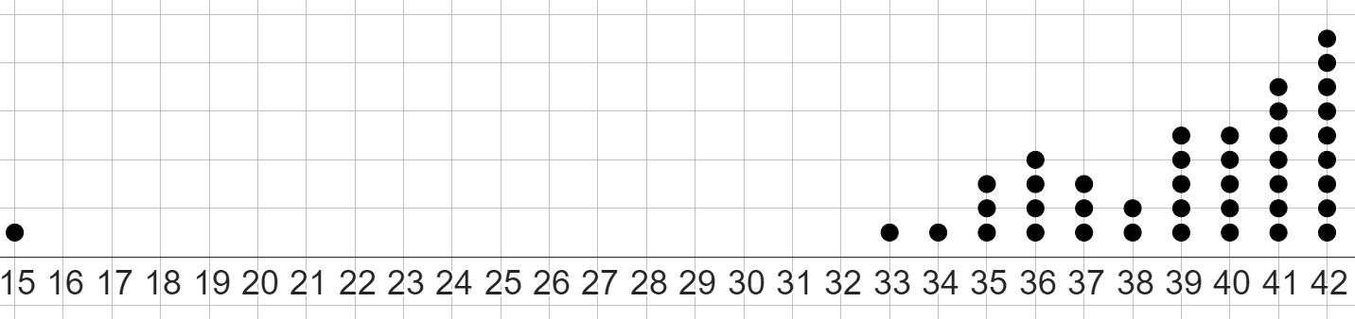
Outliers and their effect on the range
1)
a) Circle the outlier in this data set.
b) What is the original range of this data set?
c) If a data point for the number 39 was removed, by how much would the range change? Explain your answer.
d) Remove the outlier from the data set. Calculate the new range.

Slide 16
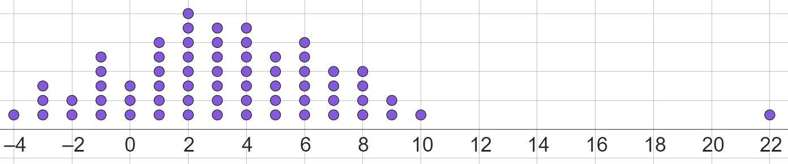
Outliers and their effect on the range
2)
a) Circle the outlier in this data set.
b) What is the original range of this data set?
c) If a data point for the number −4 was removed, by how much would the range change? Explain your answer.
d) Remove the outlier from the data set. Calculate the new range.

Slide 17
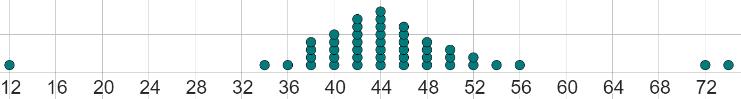
Outliers and their effect on the range
3) All data points in this data set are even numbers.
a) What are the values of the three outliers?
b) By how much would the range decrease by if all the outliers were removed?

Slide 18
Outliers and their effect on the range
1.5 | 14.5 | 16.9 | 21 | 24.2 | 28.3 | 31.9 | 33.8 | 37.7 | 38.8 | 39.9 | 42.5 | 45.2 | 46.8 | 82.5
4) Complete each sentence with a number from the dataset:
the original range is
removing the data point 37.7 will change the new range to
if the smaller outlier was removed from the original data set, the new range would be
if the larger outlier was removed from the original data set, the new range would be
the outlier that would be more impactful to remove is

Slide 19
Outliers and their effect on the range
1)
a) Circle the outlier in this data set.
range is 27
b) What is the original range of this data set?

Slide 20
Outliers and their effect on the range
c) If a data point for the number 39 was removed, by how much would the range change? Explain your answer.
Would not change, as 39 is neither the smallest or largest data point.
d) Remove the outlier from the data set. Calculate the new range.
42 − 33 = 9
The new range is 9

Slide 21
Outliers and their effect on the range
2)
a) Circle the outlier in this data set.
range is 26
b) What is the original range of this data set?

Slide 22
Outliers and their effect on the range
c) If a data point for the number −4 was removed, by how much would the range change? Explain your answer.
The range would decrease by 1 to 25
This is because -4 is the smallest data point.
d) Remove the outlier from the data set. Calculate the new range.
10 − (−4) = 14 The new range is 14

Slide 23
Outliers and their effect on the range
3) All data points in this data set are even numbers.
a) What are the values of the three outliers?
12, 72, 74
b) By how much would the range decrease by if all the outliers were removed?
The range is currently 62
Without the three outliers, the range would become:
56 − 34 = 22
The range would decrease by 40

Slide 24
Outliers and their effect on the range
1.5 | 14.5 | 16.9 | 21 | 24.2 | 28.3 | 31.9 | 33.8 | 37.7 | 38.8 | 39.9 | 42.5 | 45.2 | 46.8 | 82.5
4) Complete each sentence:
the original range is
81
removing the data point 37.7 will change the new range to
81
if the smaller outlier was removed from the original data set, the new range would be
68
if the larger outlier was removed from the original data set, the new range would be
45.3
the larger outlier: 82.5
the outlier that would be more impactful to remove is

Slide 25
Evaluating the range
Outliers and their effect on the range
Evaluating if removing outliers is sensible

Slide 26
Evaluating if removing outliers is sensible
Outliers created from errors in data collection must always be removed.
Below is a data set of maximum daily temperatures (in °C) in Lerwick, from 1941–1942. The results have been placed in order of temperature, smallest first.
3.1 | 7.3 | 9.6 | 12.7
3.5 | 7.3 | 9.7 | 13.3
3.8 | 7.3 | 10.3 | 13.7
4.2 | 7.4 | 10.5 | 13.9
4.4 | 7.9 | 11.9 | 14.5
5.6 | 9.2 | 12.6 | 152
The range of this data set is 148.9°C.
Does this seem sensible?
This is clearly an error. The real temperature may be 15.2°C, due to a missing decimal point.

Slide 27
Evaluating if removing outliers is sensible
Outliers created from errors in data collection must always be removed.
Below is a data set of maximum daily temperatures (in °C) in Lerwick, from 1941–1942. The results have been placed in order of temperature, smallest first.
3.1 | 7.3 | 9.6 | 12.7
3.5 | 7.3 | 9.7 | 13.3
3.8 | 7.3 | 10.3 | 13.7
4.2 | 7.4 | 10.5 | 13.9
4.4 | 7.9 | 11.9 | 14.5
5.6 | 9.2 | 12.6 | 152
By removing this outlier, the range becomes 9.5°C.
This is a much more sensible range of temperatures.

Slide 28
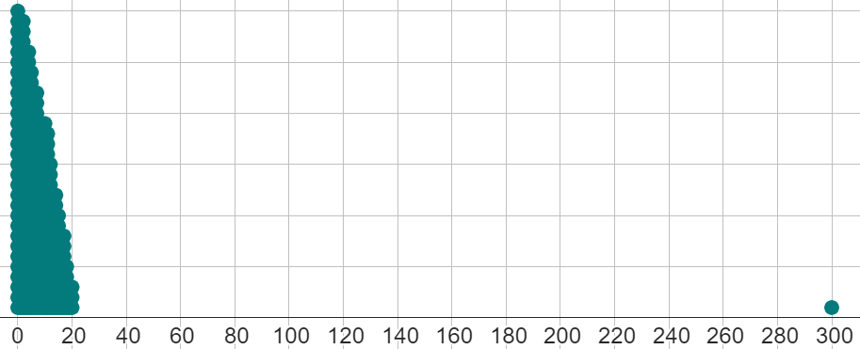
Evaluating if removing outliers is sensible
Outliers may be omitted from graphs if the readability of the graph is low because of the outlier.
Omitted doesn’t mean removed completely, just taken off of a graph. The existence of this outlier may be shown in other ways.
This dot plot shows the number of daily website visits a blogger received.
There are no errors in the data collection or representation.

Slide 29
Evaluating if removing outliers is sensible
Outliers may be omitted from graphs if the readability of the graph is low because of the outlier.
Omitted doesn’t mean removed completely, just taken off of a graph. The existence of this outlier may be shown in other ways.
The outlier of 300 is due to their blog being promoted on that day.
It is unfair to remove this data point completely, but the dot plot has little readability with the data point shown.

Slide 30
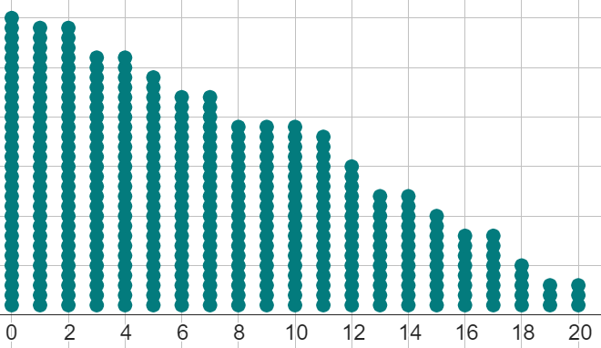
Evaluating if removing outliers is sensible
Outliers may be omitted from graphs if the readability of the graph is low because of the outlier.
Omitted doesn’t mean removed completely, just taken off of a graph. The existence of this outlier may be shown in other ways.
Without the outlier shown, the dot plot is readable.
In cases like these, we can show the range in two ways.
1 extra data point of 300
range with outlier = 300
range without outlier = 20

Slide 31
Evaluating if removing outliers is sensible
Sometimes, outliers must be kept and represented, as they are important data points in the data set.
The large range created by these important outliers shows scale of the spread or variance in the data set.

Slide 32
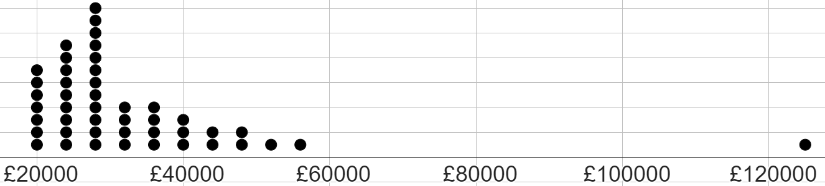
Evaluating if removing outliers is sensible
The range of salaries in this business is £105 000
20 | 20 | 20 | 20 | 20 | 20 | 20 | 24 | 24 | 24 | 24 | 24
24 | 24 | 24 | 24 | 28 | 28 | 28 | 28 | 28 | 28 | 28 | 28
28 | 28 | 28 | 28 | 32 | 32 | 32 | 32 | 36 | 36 | 36 | 36
40 | 40 | 40 | 44 | 44 | 48 | 48 | 52 | 56 | 125 | (in £1000s)
The dot plot and list of numerical data represent the yearly salaries of all the employees in a business.
This data point is essential to keep, as it isn’t an error. It shows the salary of the business’ CEO.

Slide 33

Evaluating if removing outliers is sensible
Sofia wants to make sure she remains hydrated, as she knows she needs to drink at least 2 litres of water a day.
She tracks the amount of water (in litres) she drinks each day for three weeks.
1.6 | 1.8 | 1.8 | 2 | 2 | 2.1 | 2.1
2.2 | 2.2 | 2.2 | 2.3 | 2.3 | 2.3 | 2.3
2.3 | 2.4 | 2.4 | 2.4 | 2.5 | 2.7 | 26
1) Write down the value of outlier.
26 is the outlier
2) Should Sofia:
a
keep the outlier
Sofia should remove the outlier because it is clearly an error.
Maybe the data point should have said 2.6
b
investigate further
c
remove the outlier

Slide 34
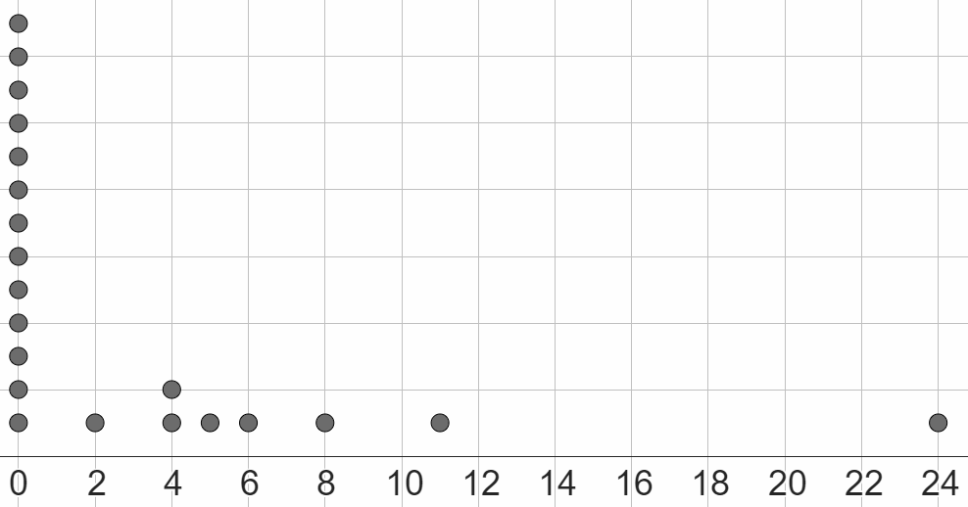
Evaluating if removing outliers is sensible
1) This dot plot shows the number of days per month that had airfrost (due to cold weather) in Leuchars (Scotland) over a 21 month period.
a) What is the value of the outlier?
b) Should the outlier be: removed, kept, or investigated further?
Write a sentence to explain the option you have chosen.

Slide 35
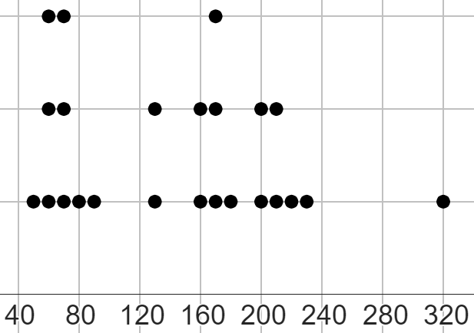
Evaluating if removing outliers is sensible
2) This dot plot shows the number of ‘hours of sunshine’ per month for two years, rounded to the nearest 10 hours.
a) What is the value of the outlier?
b) All data points have been correctly measured, with no error.
Should the outlier be: removed, kept, or investigated further?
Write a sentence to explain the option you have chosen.

Slide 36
Evaluating if removing outliers is sensible
3) This data set shows the height of 24 chimpanzees in centimetres.
1.4 | 95 | 103 | 108 | 108 | 111 | 114 | 117
118 | 118 | 124 | 125 | 129 | 132 | 135 | 138
130 | 138 | 150 | 153 | 161 | 166 | 172 | 198
a) What is the current range of this data set?
b) What is the value of the outlier or outliers in this data set?
c) Should the outlier or outliers be: removed, kept, or investigated further?
Write a sentence to explain the option you have chosen, and justify it by calculating any new range that might happen from you removing any outliers.

Slide 37
Evaluating if removing outliers is sensible
4) This data set shows the total monthly rainfall (in millimetres) each month between 2007 and 2008.
285.6 | 60
154 | 58.3
146.9 | 57.5
113 | 56.7
108.7 | 52.8
98.8 | 48.7
93.2 | 44.5
92.4 | 43.5
83.8 | 28.1
82.6 | 27.1
79.2 | 23.3
74.9 | 5.8
Jun wants to represent this data set on a dot plot, and wants to see if removing any outliers has an impact on the range of the data he has to plot.
Calculate two ranges, with one keeping the outliers, and one removing an outlier, and suggest if Jun should represent all data points on a dot plot or not.

Slide 38
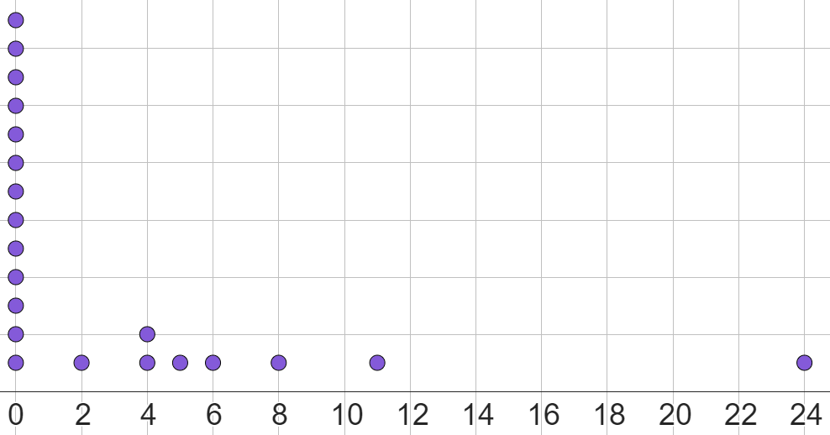
Evaluating if removing outliers is sensible
1a) What is the value of the outlier?
24 is the outlier
b) Should the outlier be: removed, kept, or investigated further?
Write a sentence to explain the option you have chosen.
Investigate further, as it is unclear whether the outlier is an error, or just a very cold month.

Slide 39
Evaluating if removing outliers is sensible
2a) What is the value of the outlier?
320 is the outlier
b) All data points have been correctly measured, with no error.
Should the outlier be: removed, kept, or investigated further?
Write a sentence to explain the option you have chosen.
The outlier should be kept, as this month might have just been a very sunny month, and this information needs to be represented.

Slide 40
Evaluating if removing outliers is sensible
3) This data set shows the height of 24 chimpanzees, in centimetres.
1.4 | 95 | 103 | 108 | 108 | 111 | 114 | 117
118 | 118 | 124 | 125 | 129 | 132 | 135 | 138
130 | 138 | 150 | 153 | 161 | 166 | 172 | 198
a) What is the current range of this data set?
196.6 cm
b) What is the value of the outlier or outliers in this data set?
1.4 is an outlier
198 may be an outlier, but this is unclear.

Slide 41
Evaluating if removing outliers is sensible
3) This data set shows the height of 24 chimpanzees, in centimetres.
1.4 | 95 | 103 | 108 | 108 | 111 | 114 | 117
118 | 118 | 124 | 125 | 129 | 132 | 135 | 138
130 | 138 | 150 | 153 | 161 | 166 | 172 | 198
c) Should the outlier or outliers be: removed, kept, or investigated further?
Write a sentence to explain the option you have chosen, and justify it by calculating any new range that might happen from you removing any outliers.
The outlier of 1.4 should be removed, as this is very clearly an error. Perhaps this measurement was made in metres, not centimetres. The range would decrease to 103
The data point of 198 needs to be investigated further, it might just be a very large chimpanzee!

Slide 42
Evaluating if removing outliers is sensible
4) This data set accurately shows the total monthly rainfall (in millimetres) each month for two years, between 2007 and 2008.
285.6 | 60
154 | 58.3
146.9 | 57.5
113 | 56.7
108.7 | 52.8
98.8 | 48.7
93.2 | 44.5
92.4 | 43.5
83.8 | 28.1
82.6 | 27.1
79.2 | 23.3
74.9 | 5.8
Jun wants to represent this data set on a dot plot, and wants to see if removing any outliers has an impact on the range of the data he has to plot.
Calculate two ranges, with one keeping the outliers, and one removing an outlier, and suggest if Jun should represent all data points on a dot plot or not.

Slide 43
Evaluating if removing outliers is sensible
4) This data set accurately shows the total monthly rainfall (in millimetres) each month for two years, between 2007 and 2008.
285.6 | 60
154 | 58.3
146.9 | 57.5
113 | 56.7
108.7 | 52.8
98.8 | 48.7
93.2 | 44.5
92.4 | 43.5
83.8 | 28.1
82.6 | 27.1
79.2 | 23.3
74.9 | 5.8
original range = 279.8
If the outlier of 285.6 is removed from the data set, the new range becomes 148.2.
Jun should omit the outlier from the dot plot, as the range nearly halves without it. However, the outlier should still be acknowledged, in case that month was just very rainy!

Slide 44
Evaluating the range
Understanding that an outlier is a data point that does not follow the trend of the rest of the data set is important to identifying outliers.
Removing an outlier may be helpful in making the range a more representative measure of the data set.
Outliers must be investigated further before removal, and only removed if it is an error.
Outliers should not be removed when they have significance to the data set. It may be that identifying the outlier means a question can be reframed for the next cycle through the data cycle.

Slide 45

© Oak National Academy 2023.
Produced in partnership with Mathematics in Education and Industry.
Licensed on the Open Government Licence v3.0, except where otherwise stated. See Oak terms and conditions.

